Slide 1
Final Project
Ufoma Iduh, Daniel Pimentel, and Marie-Jeanne Beda

Slide 2
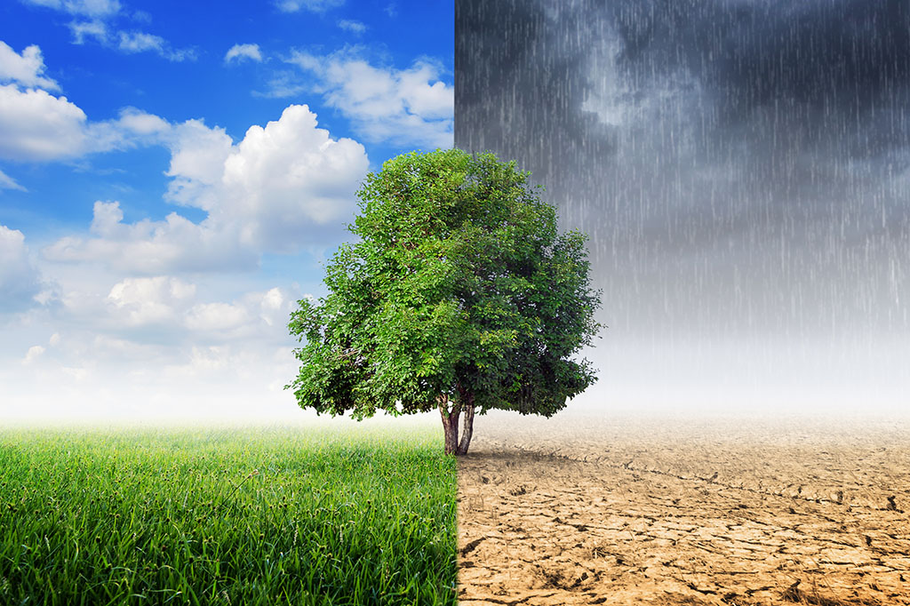
What is our question?
Georgia weather
Isn’t always great
Predict whether tomorrow will be a “good” or “bad day”?
Obviously, Georgia weather is never consistent
Can we use machine learning and create a model that can predict whether or not I should plan a picnic tomorrow?

Slide 3
Our Criteria for a “Good”/ “Bad” day
Good Day
Precipitation : 0
Temperature : >70 and < 80 degrees Fahrenheit
Score : 2
Bad Day
Precipitation : >0
Temperature : < 70 or >80 degrees Fahrenheit
Score : 1

Slide 4
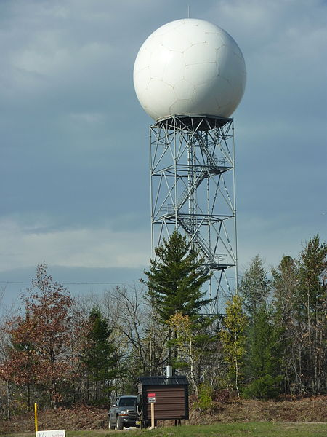
Our Dataset
26,000 row CSV
Pulled data online from data.gov
Data was pulled from a combination of locations in Southeastern United States
5 Columns
Date
Average Temperature
Precipitation
Snow/Ice
Snow depth

Slide 5
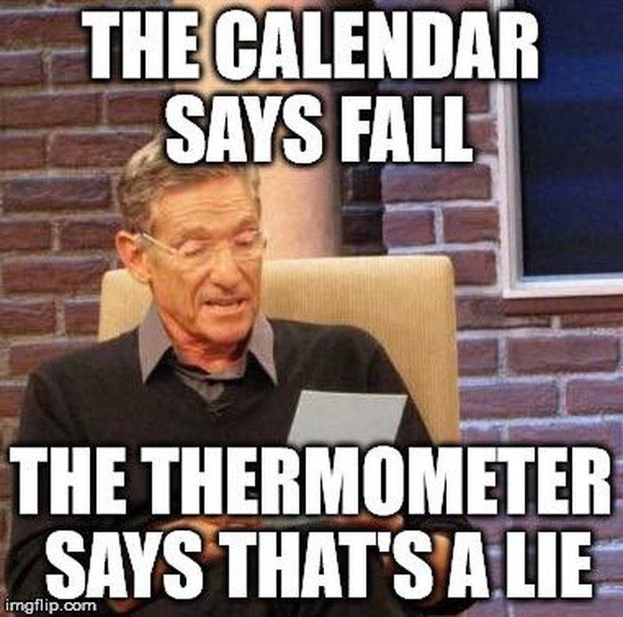

Slide 6
Technologies Used
Pandas
Used to clean up data
SciKit-Learn
Machine Learning
Matplotlib
Create Visualizations in Jupyter notebook to help analysis
Tableau
Used to create visualizations to summarize our data
Numpy
We utilized numpy assign 1 or 2 for “good” / “bad” days
Juypter Notebook

Slide 7
Steps
Imported libraries
Read the dataset
Created matplotlib scatter plot
Cleaned up data
Created model
Trained/Fit our model
Predict

Slide 8
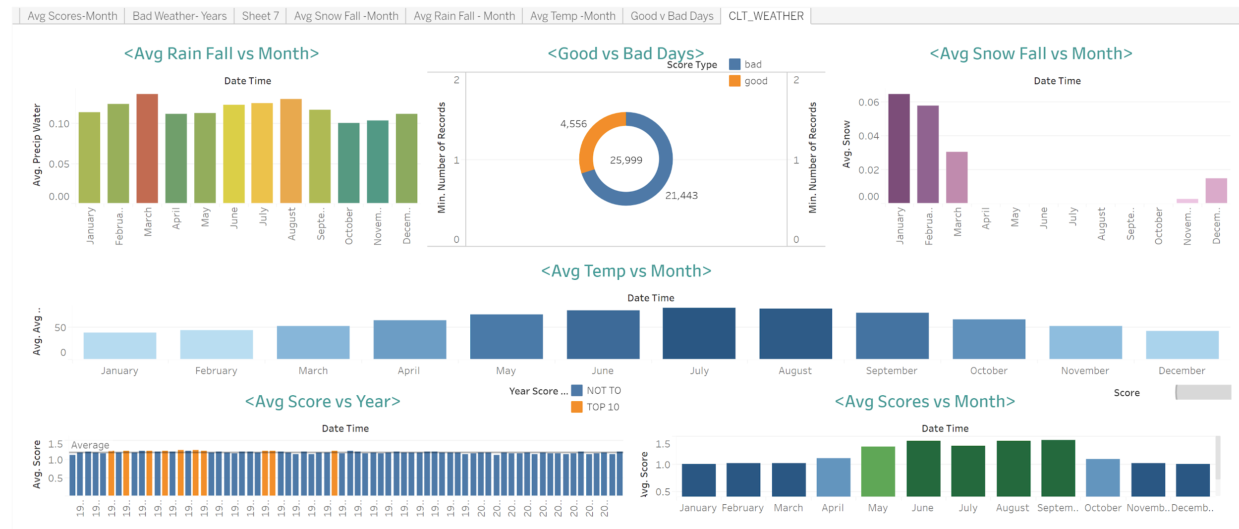
Overall Trends
Tableau Dashboard….
Notes:
https://public.tableau.com/profile/marie.b8751#!/vizhome/Final_project_15807813636470/CLT_WEATHER?publish=yes

Slide 9
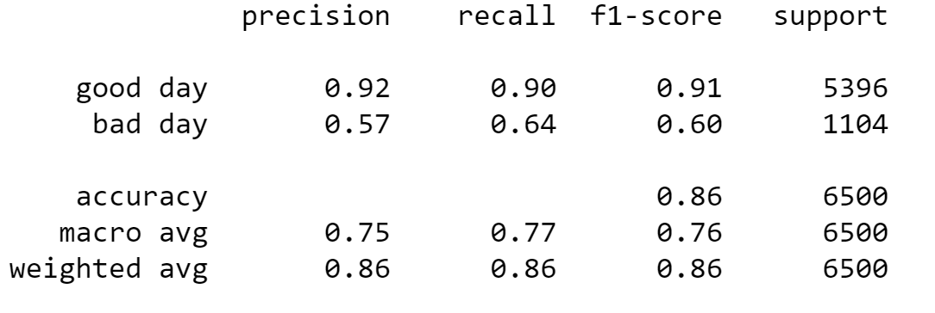
And the model says….
Notes:
Precision : number of true positives over the number of true positives plus number of false positives
Recall : number of true positives over the number of true positives plus number of false negatvies
F1 score : average between precision and recall

